Slide 1
XTTS: a Massively Multilingual Zero-Shot Text-to-Speech Model
INTERSPEECH 2024

Slide 2
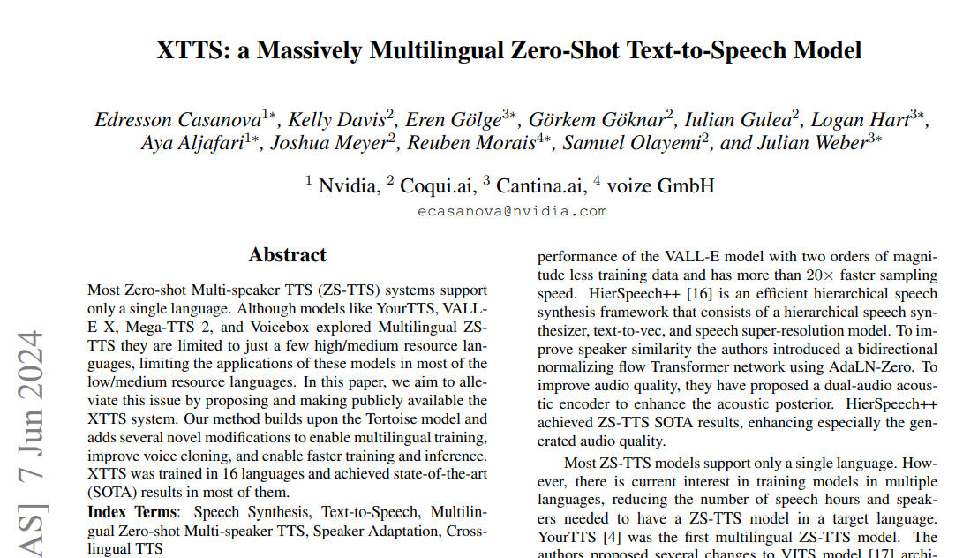
Outline
Introduction
Method
Experiments

Slide 3
Introduction
Goal:
Most of multilingual Zero Shot TTS (ZS-TTS) they are limited to just a few high/medium resource languages
Try to improve the multilingual ZS-TTS with low/medium resource languages.
Achievement
XTTS is trained in 16 languages and achieved state-of-the-art (SOTA) results in most of them.

Slide 4
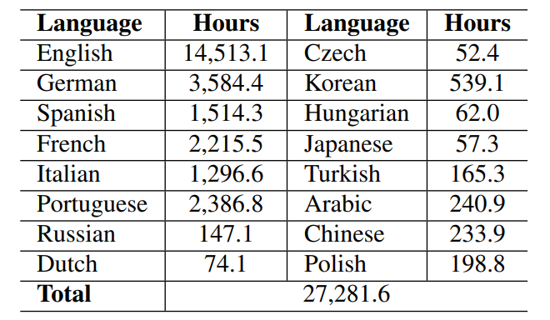
Introduction
Table from ¹
Dataset hour count
¹Casanova, Edresson, et al. "XTTS: a Massively Multilingual Zero-Shot Text-to-Speech Model." arXiv preprint arXiv:2406.04904 (2024).

Slide 5
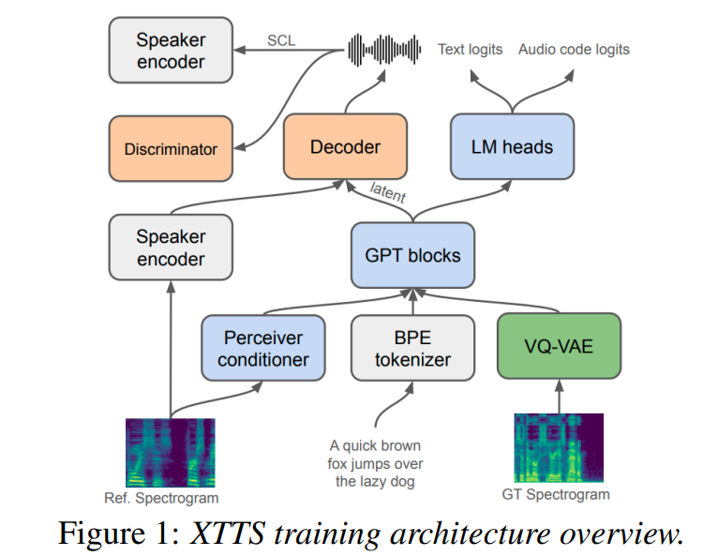
Method
Speaker consistency loss
Picture from ¹
For output fixed length latent
¹Casanova, Edresson, et al. "XTTS: a Massively Multilingual Zero-Shot Text-to-Speech Model." arXiv preprint arXiv:2406.04904 (2024).

Slide 6
Method
GPT try to predicts VQ-VAE codes
Picture from ¹
¹Casanova, Edresson, et al. "XTTS: a Massively Multilingual Zero-Shot Text-to-Speech Model." arXiv preprint arXiv:2406.04904 (2024).

Slide 7
Method
Picture from ¹
ECAPA2
HI-FI GAN
¹Casanova, Edresson, et al. "XTTS: a Massively Multilingual Zero-Shot Text-to-Speech Model." arXiv preprint arXiv:2406.04904 (2024).

Slide 8
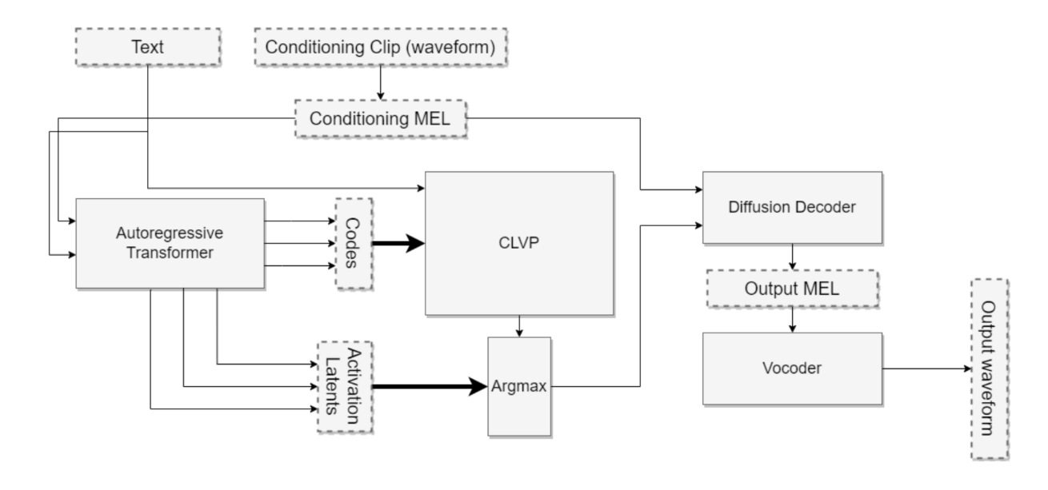
Tortorise model

Slide 9
Tortorise model

Slide 10
Experiment GPU requirement
YourTTS run on a single NVIDIA A100 with 80 GB GPU
XTTS run on 4 single NVIDIA A100 with 80 GB GPUs

Slide 11
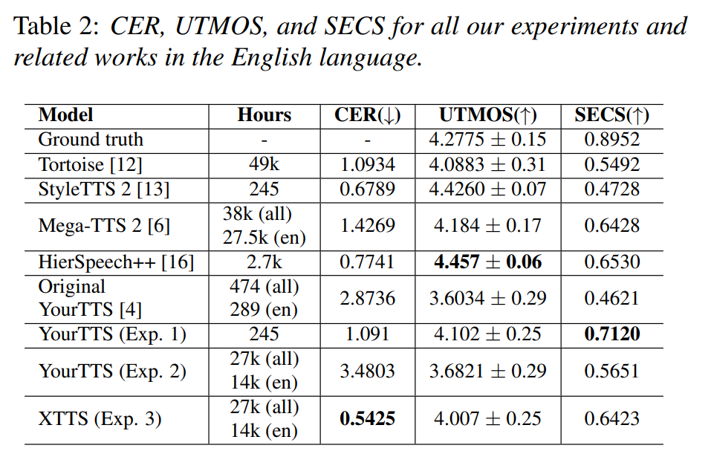
Experiment
Table from ¹
Test on FLORES+
¹Casanova, Edresson, et al. "XTTS: a Massively Multilingual Zero-Shot Text-to-Speech Model." arXiv preprint arXiv:2406.04904 (2024).

Slide 12
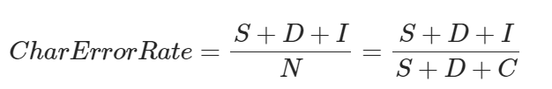
CER
Use Whisper Large v3 model to recognize the character and to the computing below:
S is the number of substitutions,
D is the number of deletions,
I is the number of insertions,
C is the number of correct characters,
N is the number of characters in the reference (N=S+D+C).

Slide 13
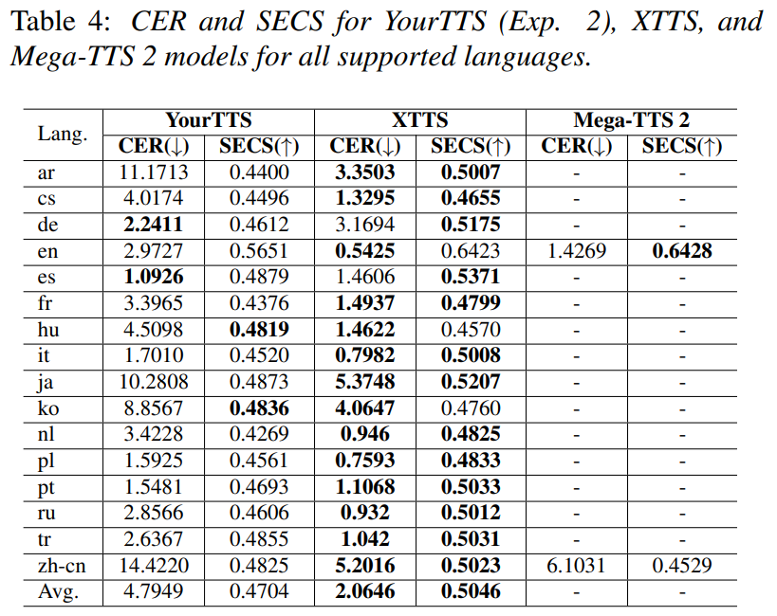
Experiment
Table from ¹
¹Casanova, Edresson, et al. "XTTS: a Massively Multilingual Zero-Shot Text-to-Speech Model." arXiv preprint arXiv:2406.04904 (2024).

Slide 14
Summary Comtribution
XTTS is a new multilingual ZS-TTS model that achieves SOTA results in 16 languages
XTTS is the first massively multilingual ZS-TTS model supporting low/medium resource languages
XTTS can perform cross-language ZS-TTS without needing a parallel training dataset.

Slide 15
Ref.
Casanova, Edresson, et al. "XTTS: a Massively Multilingual Zero-Shot Text-to-Speech Model." arXiv preprint arXiv:2406.04904 (2024).

